Slide 1

Talking Transportation Technology (T3) Webinars
Tuesday, July 18, 2023 – 1:00PM
Traveler Information and Traffic Incident Management (TIM) Part 3 of 5 in the Crowdsourcing for Operations Course via Webinar
Course developed by the Federal Highway Administration (FHWA) Every Day Counts (EDC)
Crowdsourcing for Operations

Slide 2


Talking Transportation Technology (T3) Webinars are brought to you by the Intelligent Transportation Systems (ITS) Professional Capacity Building (PCB) Program of the U.S. Department of Transportation’s (USDOT) ITS Joint Program Office (JPO)
For more information, visit: www.pcb.its.dot.gov

Slide 3
PDH Policy
The T3 Webinar Program does not officially offer Professional Development Hours (PDHs); however, your participation in a T3 Webinar may qualify as PDH-eligible activity with your licensing agency.
Upon request, the T3 Webinar Program can provide a letter verifying your attendance. Please contact T3@dot.gov to make a request.
For more information, please visit: https://www.pcb.its.dot.gov/t3_pdh_policy.aspx

Slide 4

Ask a Question / Make a Comment
Use the Chat Pod
Click on Chat icon on your screen
Submit your question or comments in the Chat window
Questions/comments will be addressed after the last presentation, as time permits

Slide 5
Traffic Incident Management (TIM) and Traveler Information Part 3 of 5 in the Crowdsourcing for Operations Course via Webinar
Intelligent Transportation Systems Joint Program Office (ITS JPO) Professional Capacity Building (PCB) Program Presents
July 18, 2023
Course developed by the Federal Highway Administration (FHWA) Every Day Counts (EDC) Crowdsourcing for Operations Innovation, and delivered by the FHWA Office of Operations

Slide 6
DISCLAIMER
The U.S. Government does not endorse products or manufacturers. Trademarks or manufacturers’ names appear in this presentation only because they are considered essential to the objective of the presentation. They are included for informational purposes only and are not intended to reflect a preference, approval, or endorsement of any one product or entity.
This presentation was created and is being co-presented by both FHWA and outside parties. The views and opinions expressed during this presentation are the presenters' and do not necessarily reflect those of FHWA or the U.S. Department of Transportation (USDOT).
Except for the statutes and regulations cited, the contents of this document do not have the force and effect of law and are not meant to bind the States or the public in any way. This document is intended only to provide information regarding existing requirements under the law or agency policies.

Slide 7




Today’s Host and Presenters
Ralph Volpe, Host
EDC-6 Crowdsourcing Colead
FHWA Resource Center Operations Technical Service Team
Vaishali Shah
Senior Director of Transportation Systems
AEM Corporation
Sal Cowan
Senior Director of Mobility
New Jersey Department of Transportation (NJDOT)
John Parker
Senior Traffic Operations Project Manager
Pennsylvania Turnpike Commission (PTC)
Source: FHWA.
Source: NJDOT.
Source: Vaishali Shah.
Source: PTC.

Slide 8

Webinar Agenda
1:05 p.m. Crowdsourcing Innovation and Course Background
1:10 p.m. Traveler Information Module
1:35 p.m. TIM Module
1:55 p.m. TIM and Traveler Information at PTC
2:10 p.m. Question and Answer
*EDT Time Zone
Source: Unsplash.

Slide 9
What Is Every Day Counts?
State-based innovation deployment model
Proven but underutilized innovations
2-year cycles
http://www.fhwa.dot.gov/innovation/everydaycounts/

Slide 10

EDC-6: Deepen Crowdsourcing Roots for a Bountiful Suite of Benefits
Adding data sources and applications
Improving data management
Improving archived data usage
Sharing and integrating data
Source: FHWA.

Slide 11

Crowdsourcing Course-in-a-Box
Course Goals:
Broaden understanding and knowledge about how crowdsourced data can improve transportation operations
Help participants consider whether specific applications of crowdsourcing may meet their organizations’ needs
Course Tools:
Editable instructor templates
Instructor materials
Course slide decks
Student materials
Source: Pixabay.

Slide 12
Whom Is the Course Targeting? Transportation Groups
Public works departments
Emergency planning
Work zone managers
Safety and planning
Traffic management centers (TMCs)
Traffic signal systems administrators
Operations
Maintenance
Consider nontraditional invitees such as policymakers, locally elected officials, administrators, or other leaders.

Slide 13

Course Is Modular by Design
Five Lessons:
Six Application Modules:
Traffic Incident Management
Traveler Information
Arterial Management
Work Zone Management
Road Weather Management
Emergency Management
Data
Sources
Application
Areas
Introduction
Data
Management
Next Steps
Source: Adapted from Pixabay.
Source: Adapted from Pixabay

Slide 14
Crowdsourcing Course Delivery by Webinar
Webinar | Date | Course Lessons and Modules
1 | May 16 | Crowdsourcing Introduction and Applications Lessons
2 | June 20 | Data Sources and Management Lessons (recording coming soon)
3 | July 18 | Traveler Information and Traffic Incident Management Modules
4 | August 15 | Road Weather and Arterial Management Modules
5 | September 19 | Emergency and Work Zone Management Modules and Next Steps Lesson

Slide 15
Summary of Webinar 2 Lessons
Data Sources
Common crowdsourced data for use in Traffic System Management and Operations (TSMO) include vehicle probe; navigation, 311, and 511 applications; social media; connected vehicle; and multimodal data.
Data vendors may integrate multiple data sources using a proprietary process.
Accuracy depends on and varies with market penetration.
Data Management
Data management keeps data organized, safe, and usable. It involves the entire lifecycle of data and supporting systems.
Some crowdsourced data uses require storage and processing capabilities beyond traditional, on-premise data management systems.

Slide 16

Introductions
Please enter your name, agency, and job title in the chat window.
Source: FHWA.

Slide 17
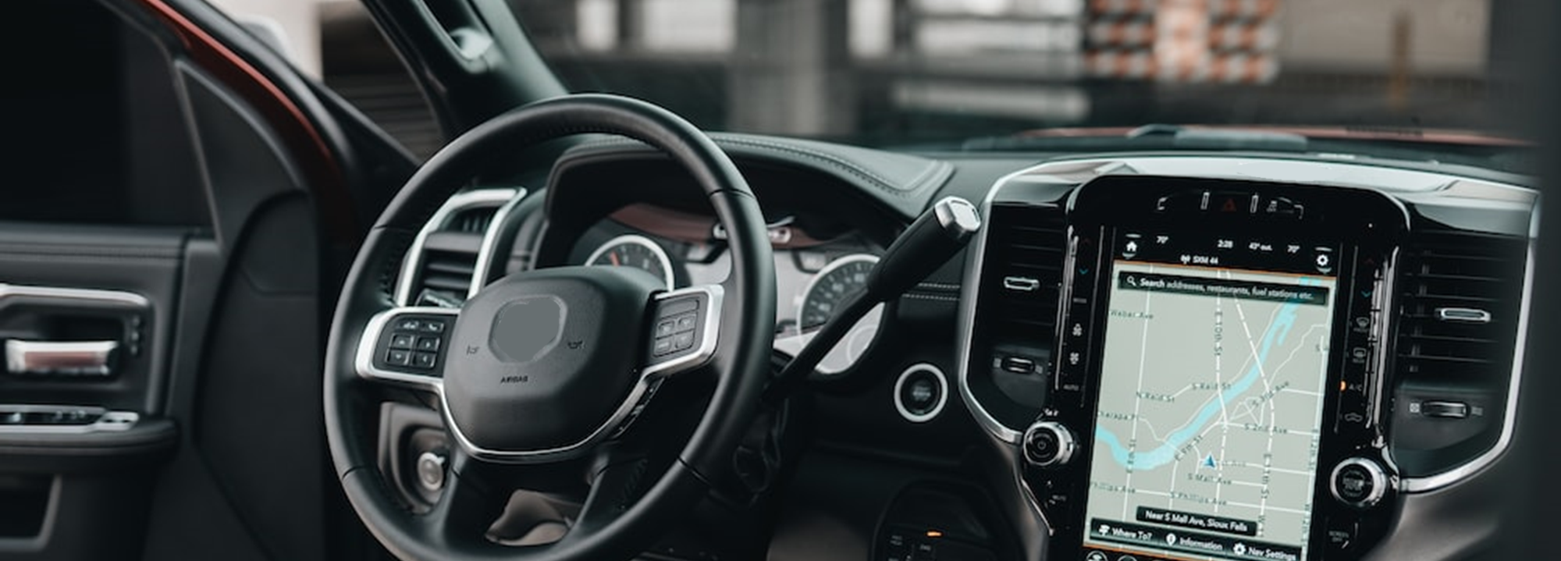
LESSON: Traveler Information INSTRUCTOR: Sal Cowan, NJDOT
Source: Unsplash.

Slide 18
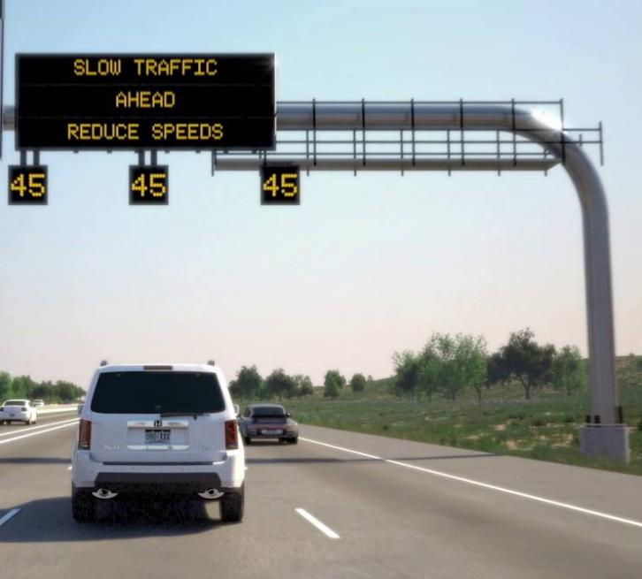
Lesson Objective
Understand how crowdsourcing data can enhance traveler information.
Learn about the different platforms for communicating traveler information.
Source: Colorado DOT

Slide 19
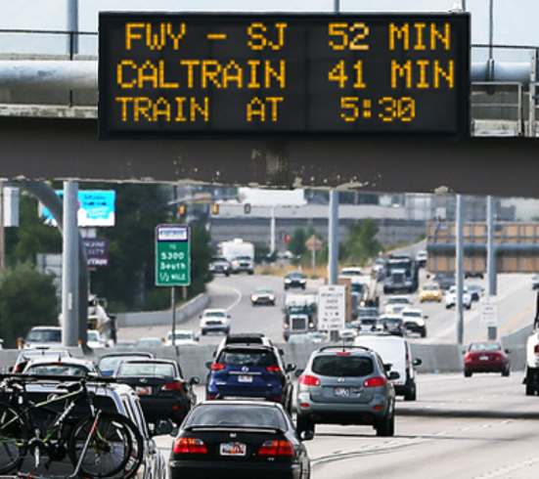
Traveler Information Challenges
Infrastructure and staffing cost to generate traveler information.
Timeliness of information.
Accuracy of information.
Jurisdictional stovepipes.
Reaching travelers on their preferred information platform.
Source: FHWA

Slide 20
Crowdsourcing Applications for Traveler Information
“Citizen-supplied data will add to the eyes and ears of Oregon Department of Transportation staff already out on the roads and highways … it greatly enhances our ability to provide up to the minute and accurate traffic data to the public.”
Oregon DOT ITS Manager
Expand geographic coverage
Quantitative predictive travel time
Detailed information on issues impacting the roadway
Improves the timeliness of traveler information

Slide 21
Traveler Information Crowdsourcing Examples
Agency | How Data is Used | Crowdsourced Data
Virginia DOT | Reaching traveler on preferred platforms, timely and accurate info | INRIX®, Waze®, Google®, Twitter
Arizona DOT | Expand geography and accuracy | INRIX®, HERE®
Kentucky Transportation Cabinet | Geographic coverage, timeliness, accuracy, and cost savings | Waze®
Pennsylvania DOT | Detailed, localized communication | INRIX®
https://www.fhwa.dot.gov/innovation/everydaycounts/edc_5/docs/crowdsourcing_applications.pdf

Slide 22
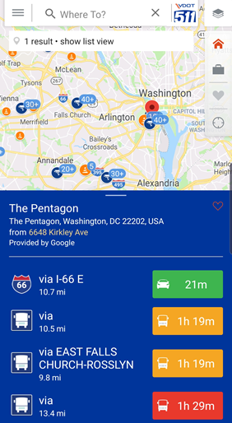
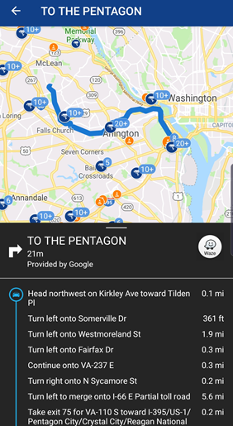
Example: Virginia DOT Integrates 511 Mobile, Web, and Navigation
Virginia DOT App and Web use Waze®, INRIX®, Google®, and State DOT data.
Push notifications and alerts
Transit and parking information
Turn-by-turn navigation and travel times
Virginia DOT notifies traveling public of road closures using Twitter.
Source: Virginia Department of Transportation

Slide 23
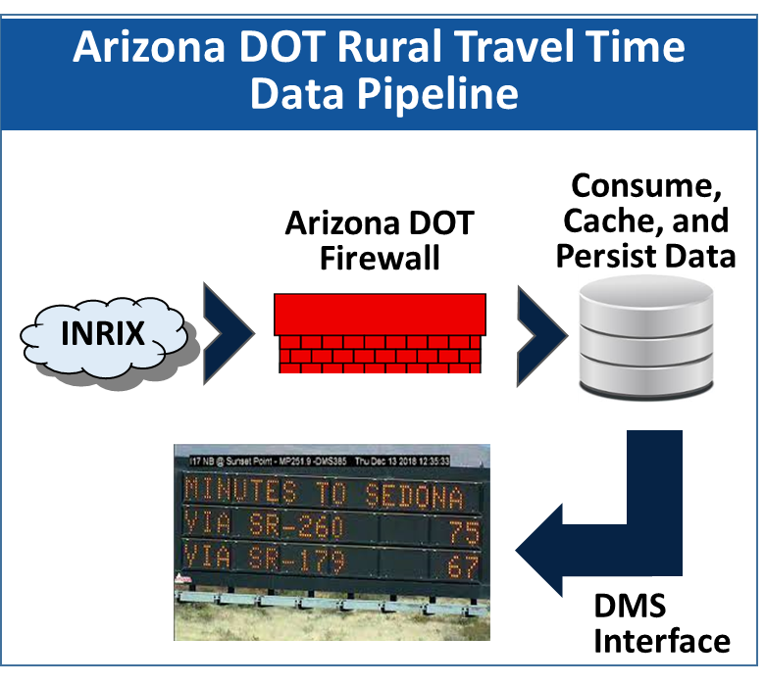
Example: Arizona DOT Traveler Information
INRIX® data to post rural road travel times.
HERE® Traffic Tiles for color-coded speed maps for AZ511.
Data is accessible to any Arizona public agency and university.
Data applied to adaptive ramp meter analysis and back of queue management.
Source: Arizona Department of Transportation

Slide 24
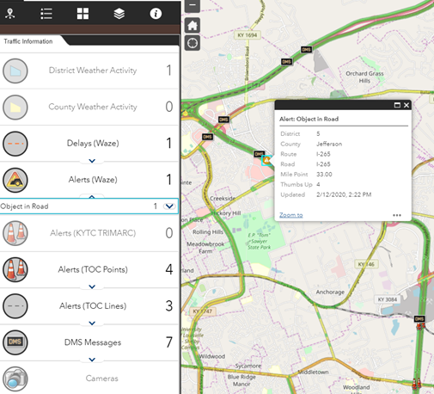
Example: Kentucky Transportation Cabinet (KYTC) 511 Website
In-house staff replaced legacy 511 system with GoKY website.
System integrates crowdsourced, agency, and other data in real-time.
KYTC shares events with Waze®.
RESULT: more timely, complete information with greater public reach at lower cost.
Source: KYTC

Slide 25
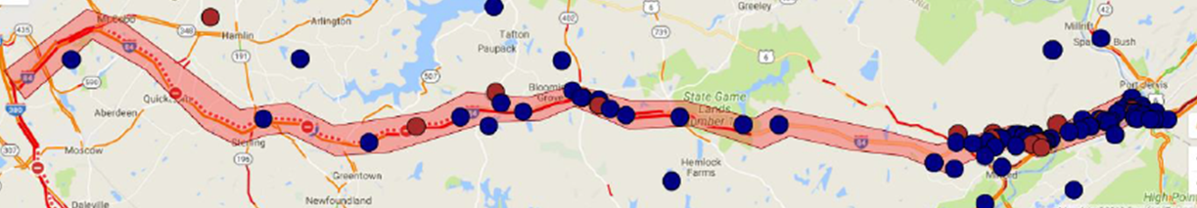
Example: Pennsylvania DOT Localized Traveler Push Notifications
Uses Highway Emergency Link Platform (HELP) by iLog® enables to notify all cell users via wide-area emergency broadcast system (like an Amber Alert).
Uses INRIX® data to identify queues and set geofenced area to send alert.
Source: Pennsylvania Department of Transportation
25

Slide 26

New Jersey Traveler Information Systems

Slide 27


How Should Agencies Communicate With Their Customers?
One to One
Mass Communication
Every Way Possible!

Slide 28
New Jersey Traveler Information
Commercial Vehicle Notifications
511 Platforms and Voice Assistant Systems
Crowdsourced Data

Slide 29


Commercial Vehicle Notifications Who Are We Working With?
Provider of North America’s largest weigh station bypass system (Drivewyze PreClear)
Provider of real time traffic data and analytics to state agencies, cities and transportation authorities worldwide

Slide 30



Which Agencies Are Involved?

Slide 31
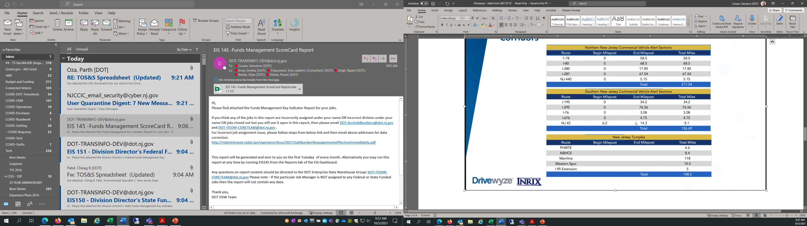
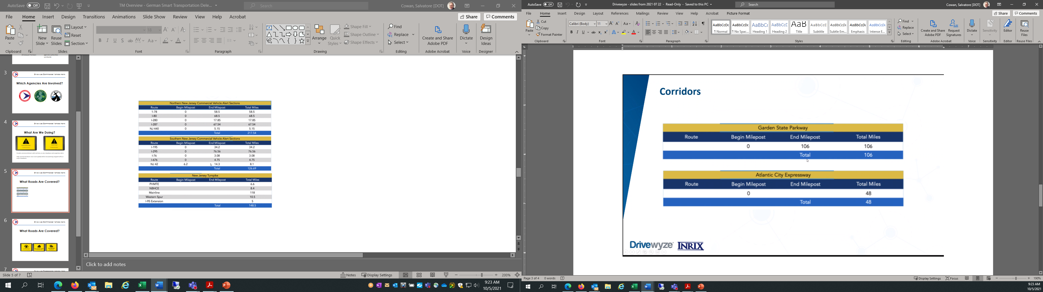
What Roads Are Covered?
Total Centerline Miles
(all three agencies)
647

Slide 32
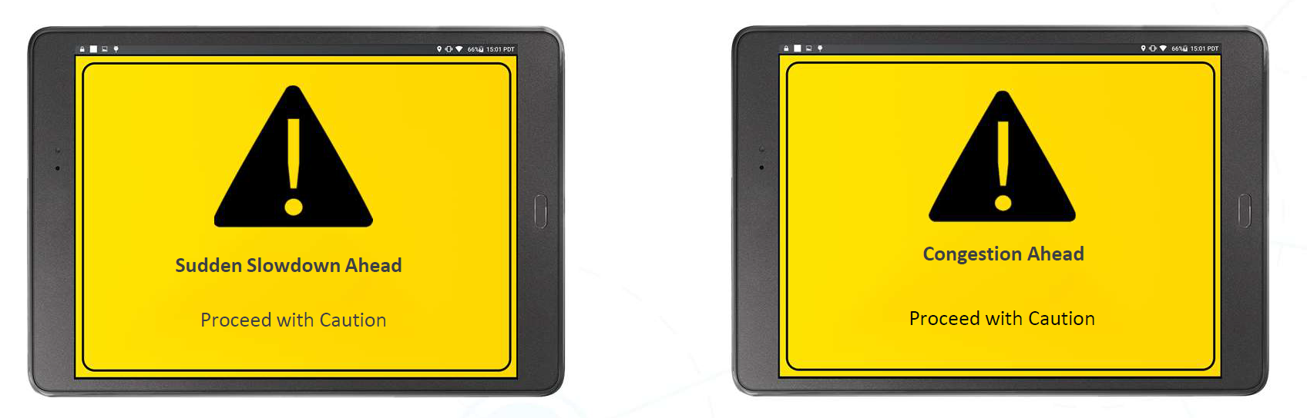
What Are We Doing?
Provide commercial drivers with real-time slowdown and congestion alerts.
Help commercial drivers react before encountering stopped traffic or slowdowns

Slide 33



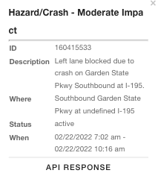
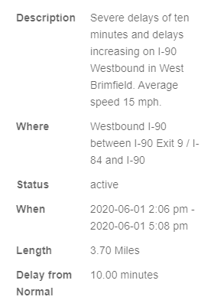
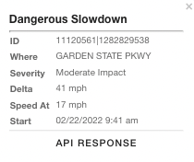
How Is It Done?
Road Closures
Congestion/Queues
Sudden Slowdowns
INRIX Traffic Intelligence -- Real-time monitoring of nationwide road network
Detects and characterizes closures, queues, and slowdowns
Updates every 60-seconds - includes location and severity

Slide 34
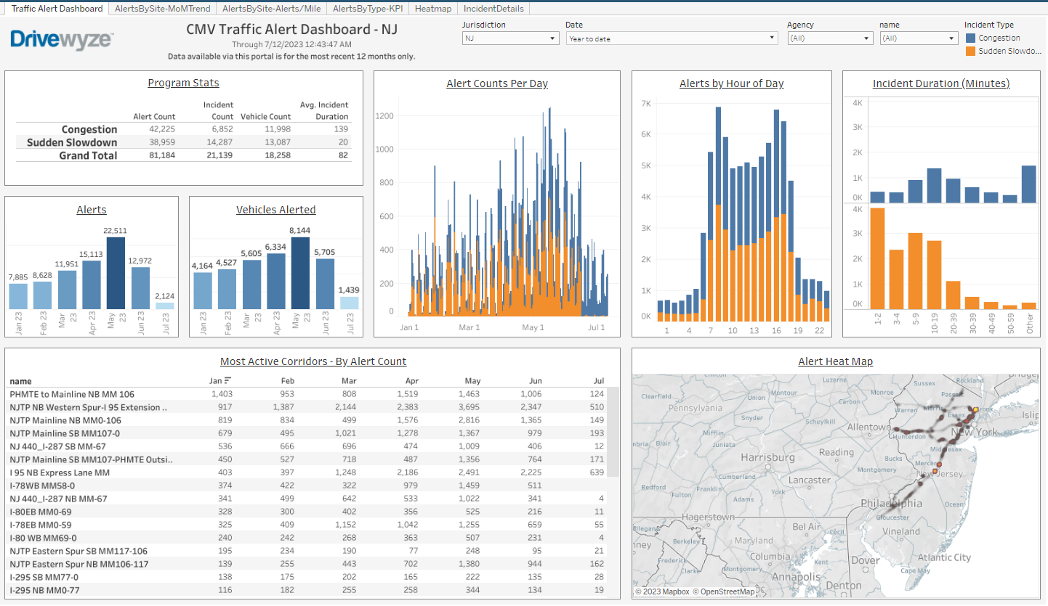
What Are We Getting?
Web-based dashboard showing # of alerts and vehicles alerted in NJ
81,000 alerts in 12 months along 13 limited access highways and toll roads

Slide 35
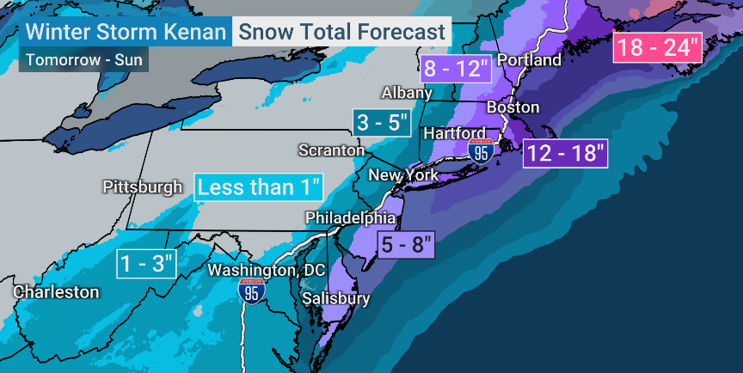
Using Technology to “Spread the Word”
January 29, 2022 – Winter Storm Kenan

Slide 36




VT 45
11 states activated 2 ¼ hours after initial request
10 states that do NOT subscribe CMV Alerts
NH 133
NY 334
MA 172
11 State agencies
1956 NB interstate road miles
RI 36
PA 908
CT 301
PA
4,811 Trucks alerted over 30-hours
NJ 776
State | Location of Alert | Number of Trucks
CT | North I-95 NB | 301
DE | North I-95 NB | 642
MD | North I-495 NB | 732
MA | North I-91 NB | 165
MA | North I-495 NB | 7
NH | North I95 NB | 133
NJ | North I-95 NB | 260
NJ | North I-295 NB | 516
NY | North I-87 NB | 25
NY | North I-495 NB | 4
NY | North I-95 NB | 305
PA | I-80 East EB | 908
RI | North I-95 NB | 36
VT | North I-91 NB | 45
VA | North I95 NB | 732
Total Number of Trucks Alerted | Total Number of Trucks Alerted | 4811
DE 642
VA 732
MD 732
NC
Example of actual ELD alert.
This also goes into any smart device.

Slide 37
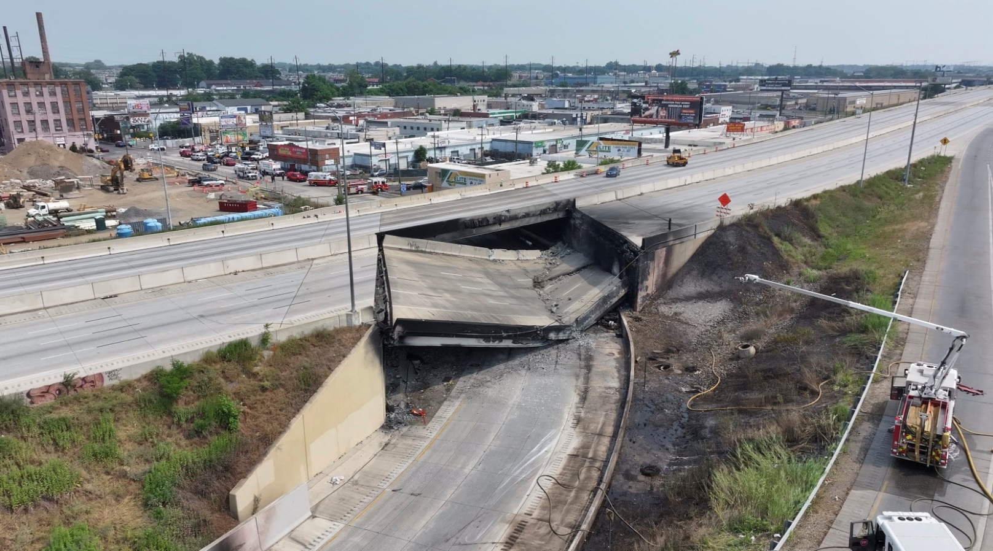
Using Technology to “Spread the Word”
June 11, 2023 - I-95 Philadelphia

Slide 38


Standardized TSMO Response
93 Variable Message Signs on 19 multi-agency roadways
511 system reporting the closure
Coordination with public and private partners (statewide & regional)

Slide 39
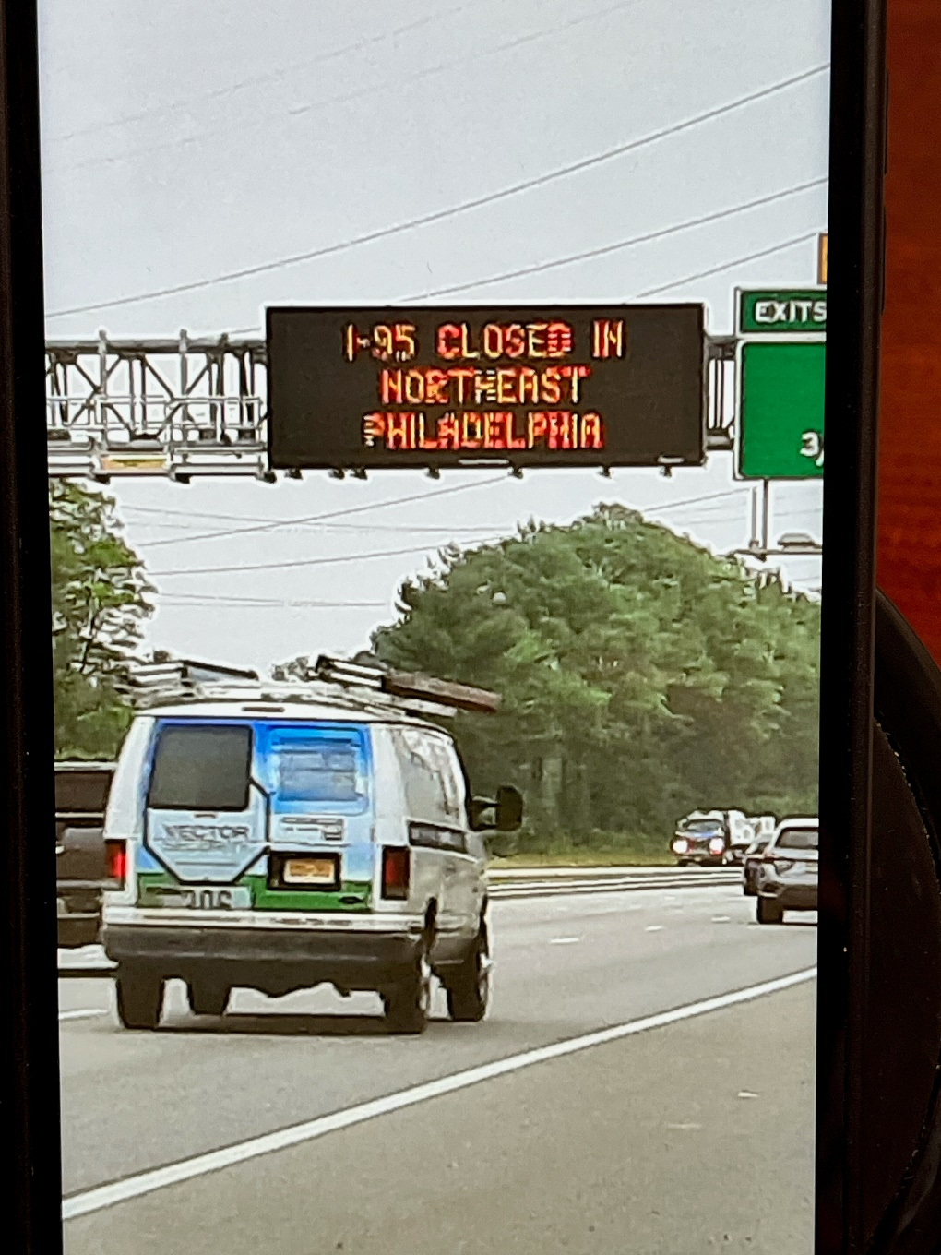
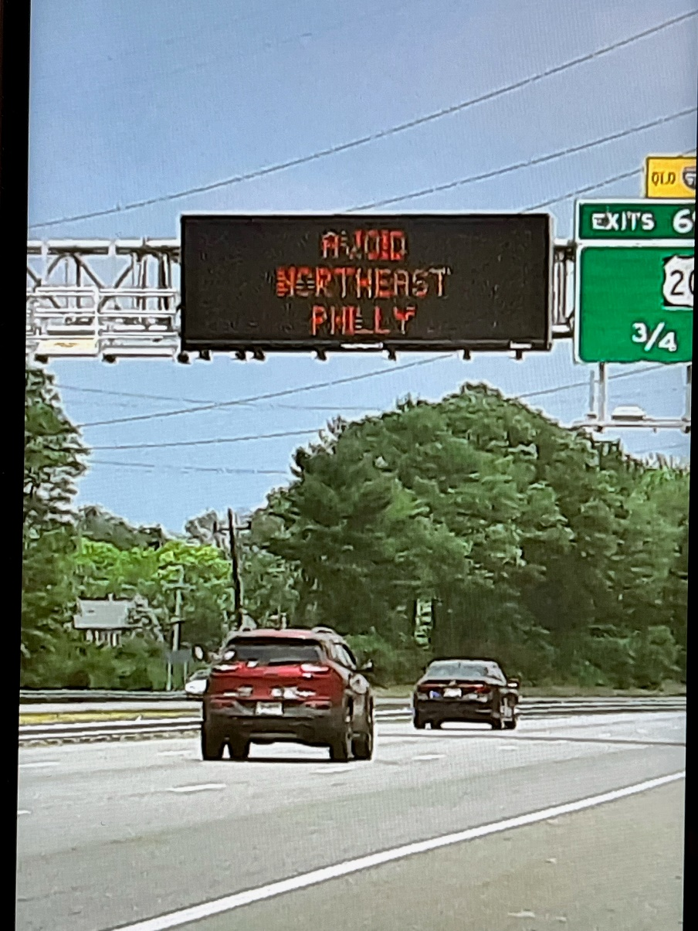
Standardized TSMO Response

Slide 40
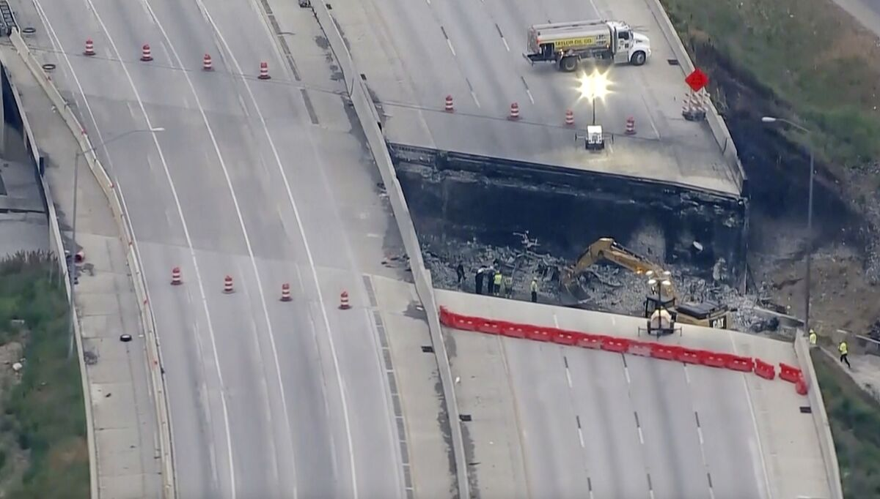
“Spread the Word Further!”
We need to communicate to as many of the 160,000 daily vehicles we can

Slide 41
GeoFenced Alerts To Trucks
Site ID | Site Name | Alerts 6/25 - 6/26 | Trucks 6/25 - 6/26 | Alerts Total | Trucks Total
21049 | PA I-95 Bridge Collapse Road Closure NB | 147 | 125 | 1151 | 899
21050 | PA I-95 Bridge Collapse Road Closure SB | 113 | 96 | 942 | 862
21051 | PA I-95 Bridge Collapse Road Closure Border Alert NB | 318 | 302 | 4373 | 3385
21052 | PA I-95 Bridge Collapse Road Closure Border Alert SB | 37 | 35 | 704 | 589
21053 | PA I-95 Bridge Collapse Road Closure Bridge Border Alert WB | 439 | 399 | 7728 | 5235
21056 | NJ I-95 Bridge Collapse SB I-295 at Exit 62 SB | 53 | 49 | 969 | 713
21057 | NJ I-95 Bridge Collapse WB 76 at I-676 WB | 121 | 112 | 1806 | 1282
21058 | NJ I-95 Bridge Collapse SB I-295 at Exit 40 SB | 158 | 154 | 3357 | 2319
21059 | NJ I-95 Bridge Collapse NB I-295 at Exit 23 NB | 458 | 381 | 5015 | 4346
21060 | NJ I-95 Bridge Collapse SB I-295 at Exit 28 SB | 218 | 208 | 4050 | 2812
21061 | NJ I-95 Bridge Collapse NB I-295 at Exit 28 NB | 254 | 239 | 4738 | 3244
21062 | NJ I-95 Bridge Collapse EB I-195 at Exit 7 EB | 130 | 127 | 1759 | 1379
21063 | MD I-95 Bridge Collapse NB I-95 at Maryland/DE border NB | 826 | 774 | 10819 | 7874
21064 | CT I-95 Bridge Collapse SB I-95 at the CT/RI border SB | 97 | 94 | 2009 | 1597
21065 | RI I-95 Bridge Collapse SB I-95 at the RI/MA border SB | 52 | 50 | 1122 | 866
21066 | NJ I-95 Bridge Collapse SB I-95 at the NJ/NY border WB | 651 | 595 | 11147 | 7636
21067 | NY I-95 Bridge Collapse SB I-95 at the NY/CT border SB | 3778 | 2,468 | 12581 | 8684
 | Total | 7,850 | 6,208 | 74,270 | 53,722
53,722 commercial vehicles alerted between June 12th and June 26th

Slide 42

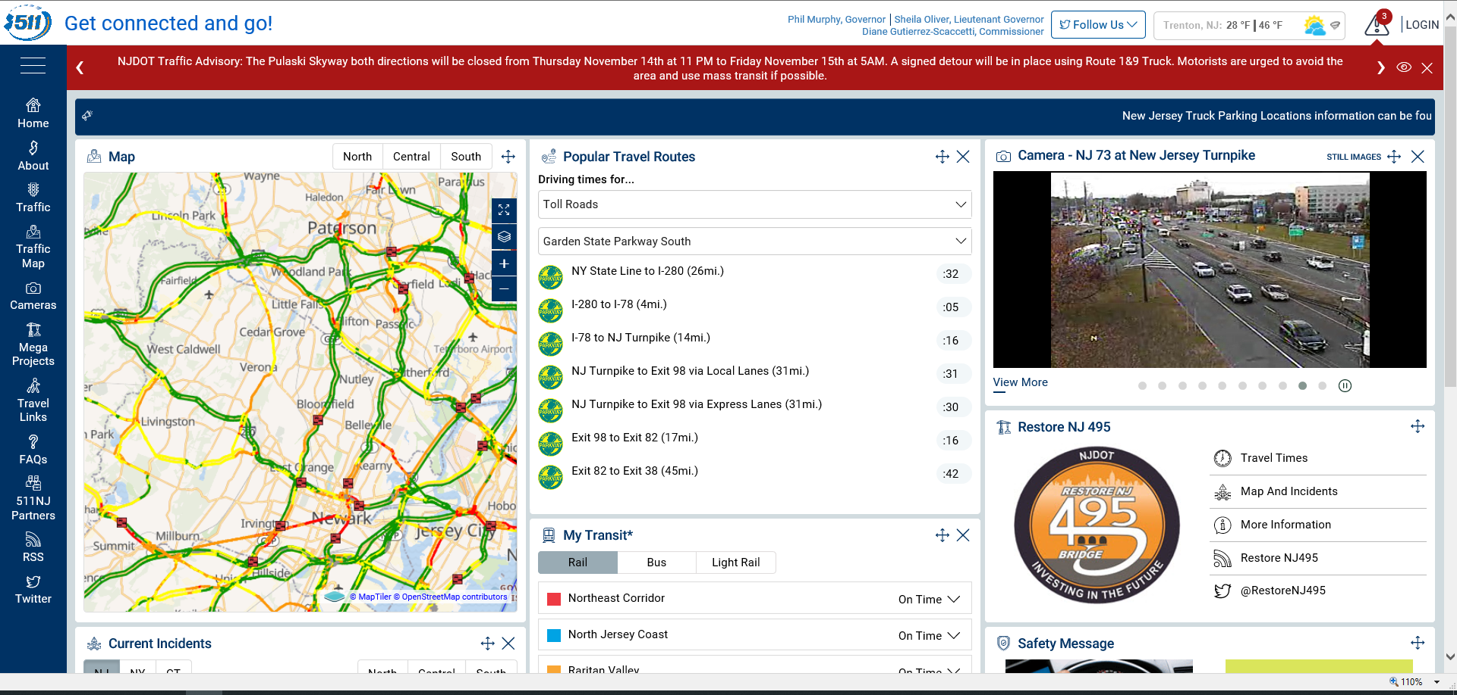

Traditional Traveler Information Platforms
Phone System
3 million calls
(2017-2022)
Website
Over 45 million visits
(2017-2022)
Social Media
17 Twitter Handles
Avg 7,700 tweets/mo

Slide 43


Intelligent Voice Assistant Platforms
In 2019, NJDOT coined the phrases…
“Alexa…talk to New Jersey Traffic”
“Hey Google…talk to New Jersey Traffic”
First State DOT in the country to use Alexa and Google Home to provide 511 information

Slide 44
Intelligent Voice Assistant Platforms
Why should DOT’s provide traffic through these devices?
500,000,000
Alexa-enabled devices
52,000,000
Google Home devices

Slide 45
What Is Crowdsourcing?
Collecting information from a group
via the internet

Slide 46


Slide 47

Does NJDOT Use Crowdsourced Data to Manage Mobility?
Yes…for more than 15 years

Slide 48
TRANSCOM Data Fusion Engine (DFE)
Roadside
Device
Identify all possible data sources
Integrate and map data sources
Develop “Business Rules” for data source
Winning Source generated by DFE
Results updated every minute
Data Archived for future analysis
Vehicle
Detector
Probe
3rd Party
“Winning Source”

Slide 49
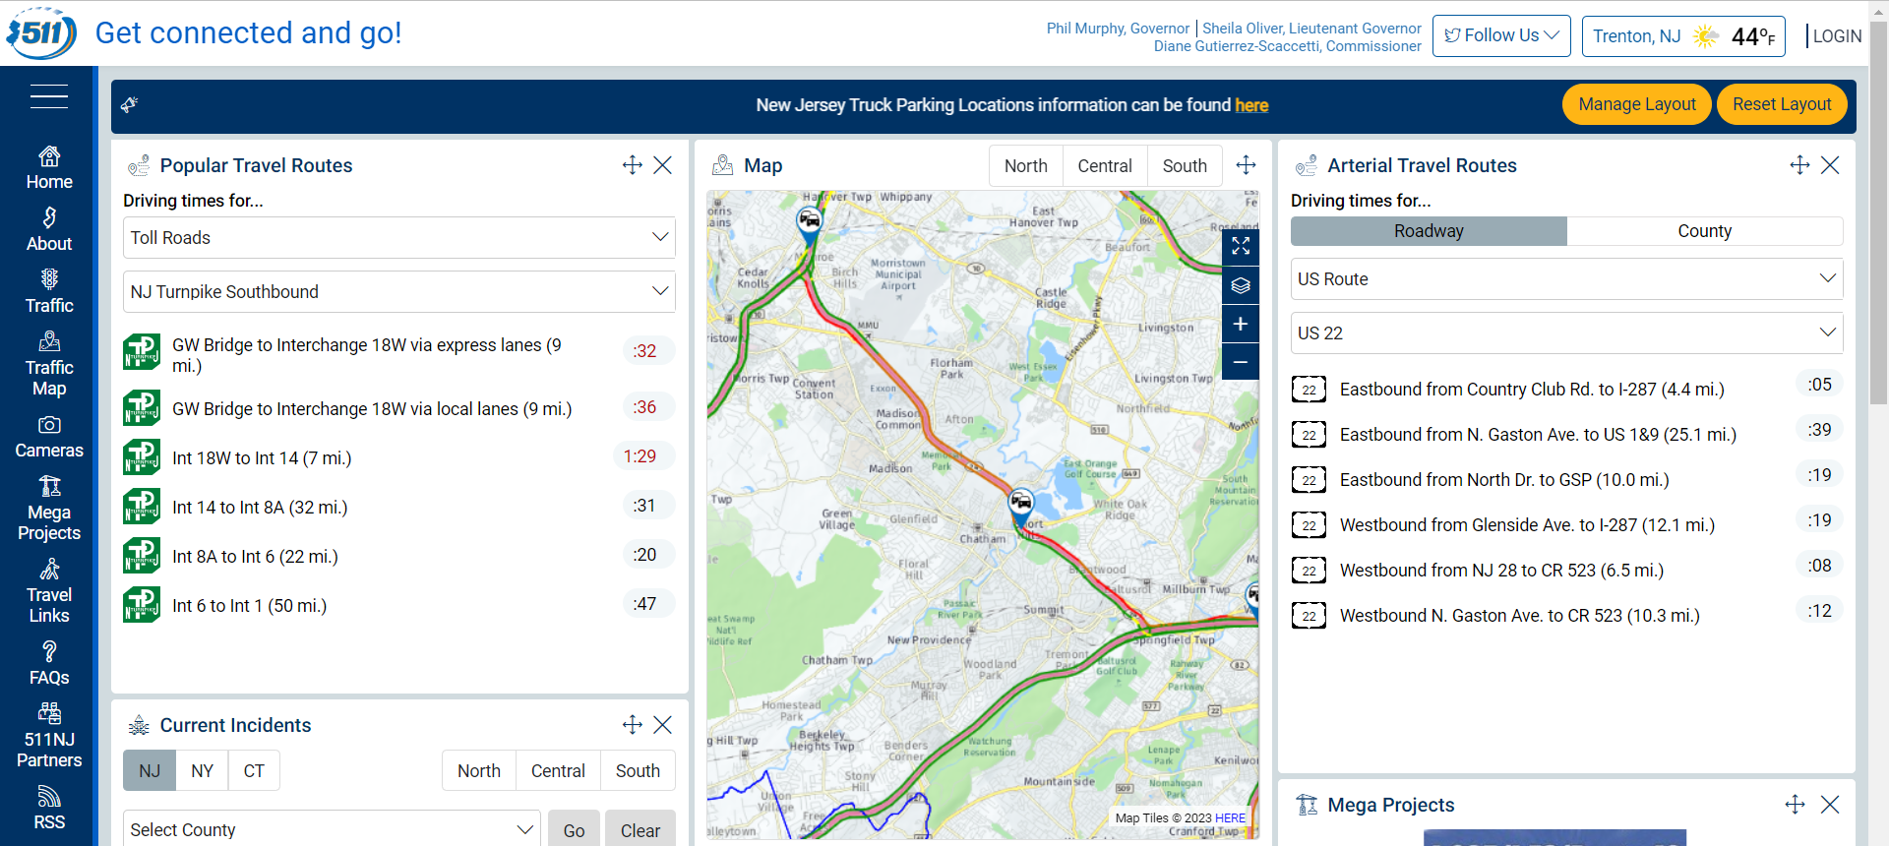
NJDOT uses of Crowdsourced Data
Public Use

Slide 50
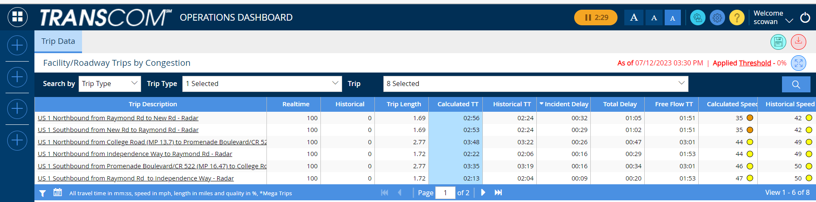
NJDOT uses of Crowdsourced Data
Agency Analytics Use

Slide 51

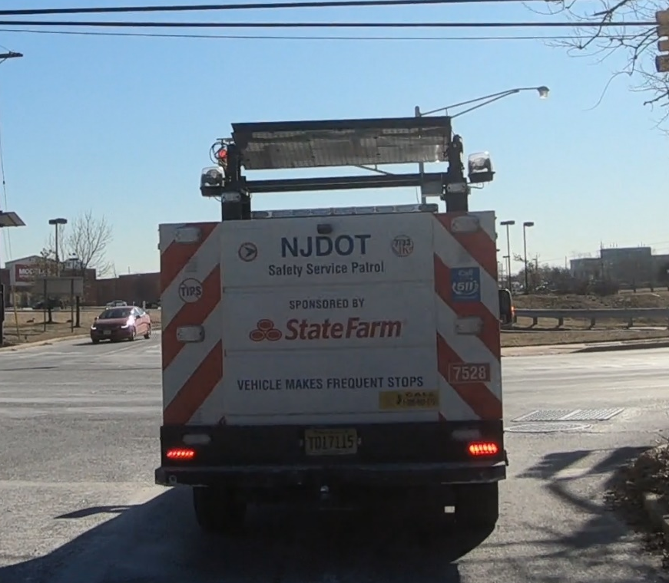
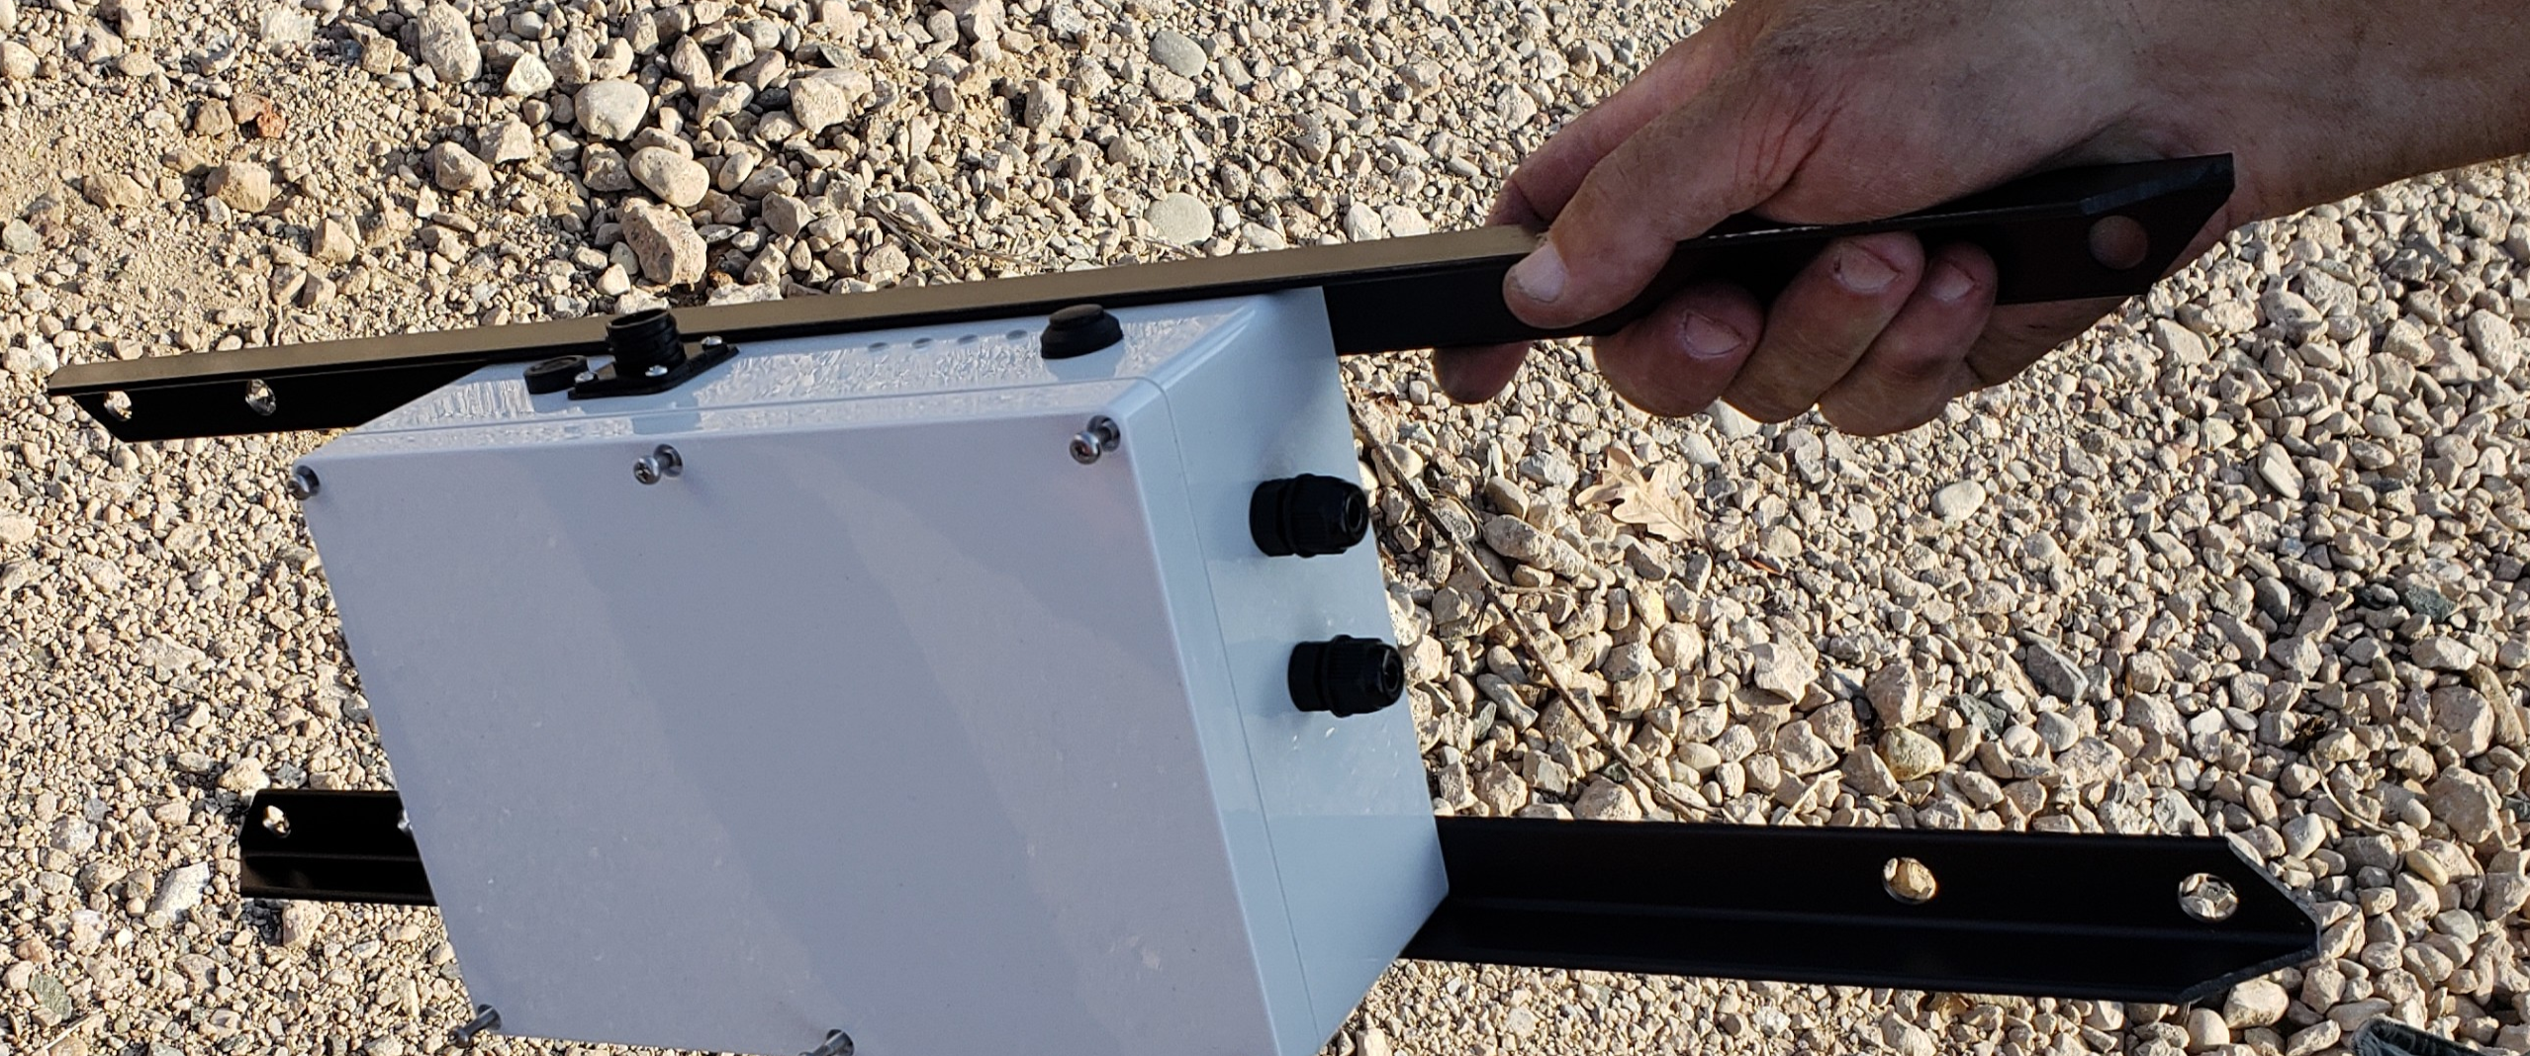
Is NJDOT “Part of the Crowd”?
Yes…..we’ve done it before!

Slide 52
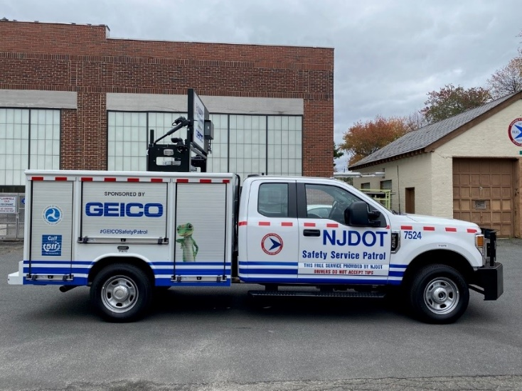


Is NJDOT “Part of the Crowd”?
And we’re doing it again!

Slide 53
One more time…. How Should Agencies Communicate With Their Customers?
One to One
Mass Communication
Every Way Possible!

Slide 54

Knowledge Check
How can crowdsourcing data enhance traveler information?
Improves timeliness
Provides better accuracy
Can be delivered to preferred platforms
All the above
D. All of the above
Source: Unsplash
54

Slide 55
Knowledge Check
What platforms can be used to acquire data and communicate traveler information?
Twitter
511 mobile app
Third-party mobile app
All the above
D. All of the above
Source: Unsplash
55

Slide 56
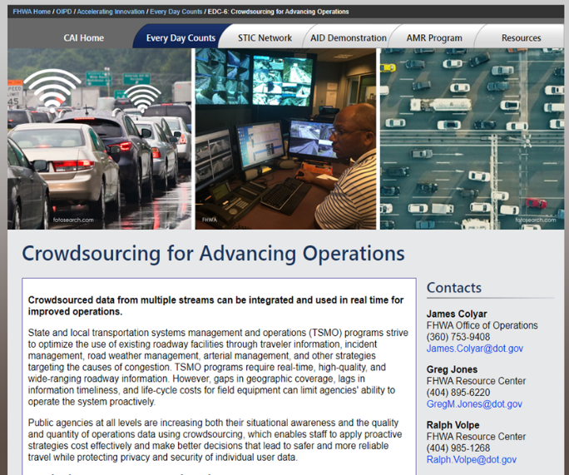
Traveler Information Crowdsourcing Resources
Adventures in Crowdsourcing webinars with Traveler Information content:
Using Crowdsourced Data for Traveler Information
Social Media for Improved Operations
Business Case for Crowdsourced Data - Missouri Personalized Traveler Information Improves Responder Safety
FHWA EDC-6 Crowdsourcing for Advancing Operation Resource Site (bit.ly/CS4Ops)

Slide 57

LESSON: Traffic Incident Management INSTRUCTOR: Vaishali Shah, AEM Corporation
Source: Unsplash.

Slide 58

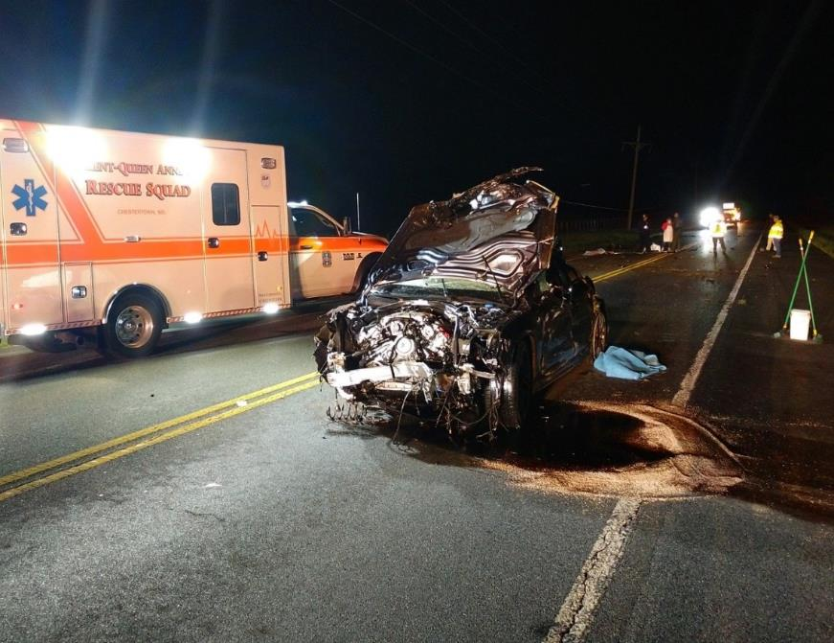


Lesson Objective
Understand how crowdsourcing data can enhance Traffic Incident Management (TIM)
Source: Maryland DOT
58

Slide 59

What is Traffic Incident Management (TIM)
TIM consists of a planned and coordinated multidisciplinary process to detect, respond to, and clear traffic incidents so that traffic flow may be restored as safely and quickly as possible.
Source: Enforcement Engineering, Inc.

Slide 60
Traffic Incidents and Secondary Crashes
"A traffic incident is an emergency road user occurrence, a natural disaster, or other unplanned event that affects or impedes the normal flow of traffic."
Manual on Uniform Traffic Control Devices 6I.01, P02
"A secondary crash is a crash that occurs within the incident scene, queue, or backup, including the opposite direction, resulting from an original traffic incident."
FHWA Focus States Initiative

Slide 61
TIM Timeline
Incident duration and the time it takes to clear roadways affects travel reliability, incident responder and motorist safety, and the likelihood of a secondary crashes.
Detection
Verification
Source: FHWA

Slide 62

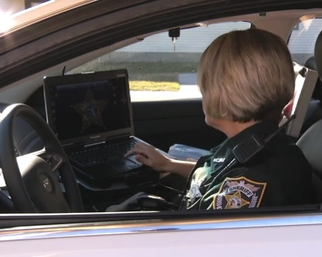
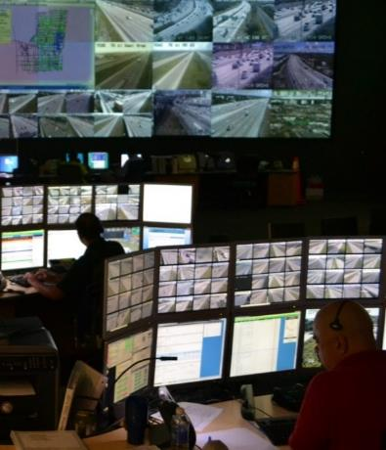
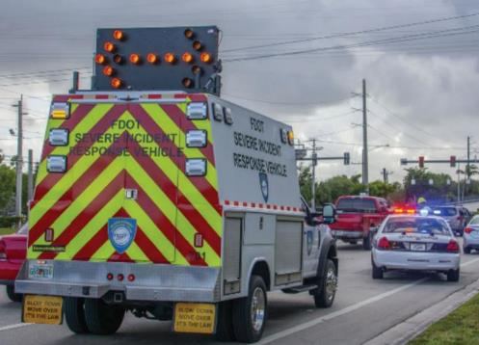
Traffic Incident Management Challenges
Incident detection
Queue formation and detection
Operator workload
The safety of responders and approaching motorists
Managing alternate routes
After action reviews
Source: Adapted from Unsplash
Source: Nassau County, FL Sheriffs Office
Source: Florida DOT
Source: Enforcement Engineering, Inc.

Slide 63
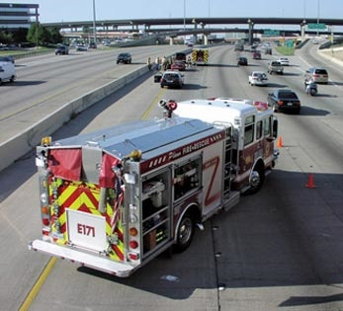
Crowdsourcing Applications for TIM
Quicker incident detection
Back of queue detection
Reduces operator workload
Responder and traveler safety
Traffic and alternate route management
After action reviews
Source: FHWA

Slide 64
TIM Crowdsourcing Examples
Agency | How Data is Used | Crowdsourced Data
Georgia DOT | Back of queue management | Waze®, INRIX®
Iowa DOT | Quicker incident detection | Waze®, INRIX®, Twitter®
City of Frisco, TX | Quicker incident detection, reduce operator workload, traveler safety | Waze®
Connecticut DOT | Incident detection and response | Waze®, HERE®
St Louis, MO | Responder and traveler safety | Make Way® and Waze®
Lake County, IL | Traffic and alternate route management | Waze®
https://www.fhwa.dot.gov/innovation/everydaycounts/edc_5/docs/crowdsourcing_applications.pdf

Slide 65
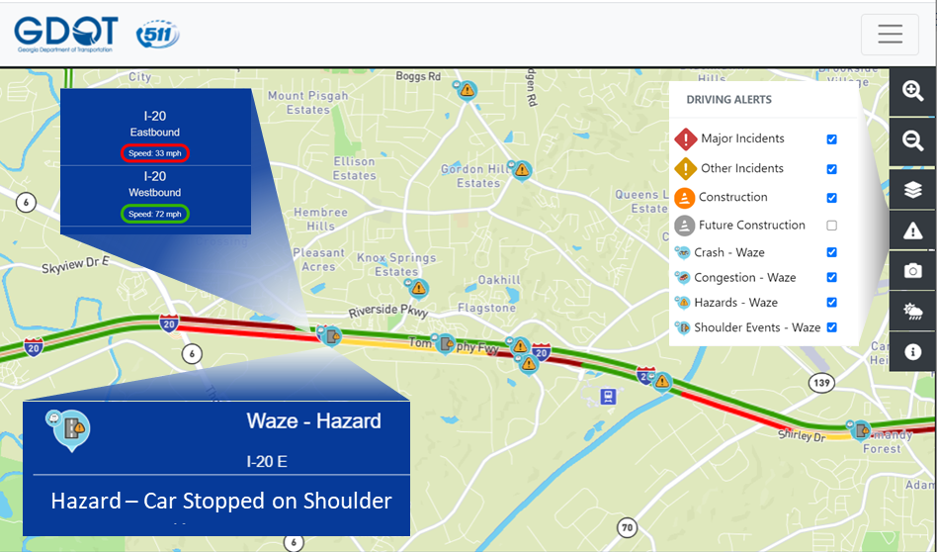
Example: Georgia DOT Manages Back of Queue Using Crowdsourced Data
Georgia DOT Safety Service Patrol uses Waze® and color-coded speed maps from their public-facing 511 site to position mobile message signs and warn approaching drivers of slow downs.
Source: Georgia DOT

Slide 66
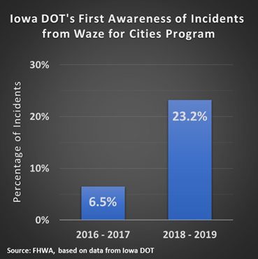
Example: Iowa DOT uses Waze to Shorten Incident Detection Time
Waze® data informs traffic management center (TMC) operators of roadway incidents in advance of other sources approximately 25 percent of the time.
Iowa DOT also uses vehicle probe data and social media to detect incidents, in addition to ITS cameras, safety service patrol, and law enforcement computer-aided dispatch.
Source: FHWA using data from Iowa DOT

Slide 67
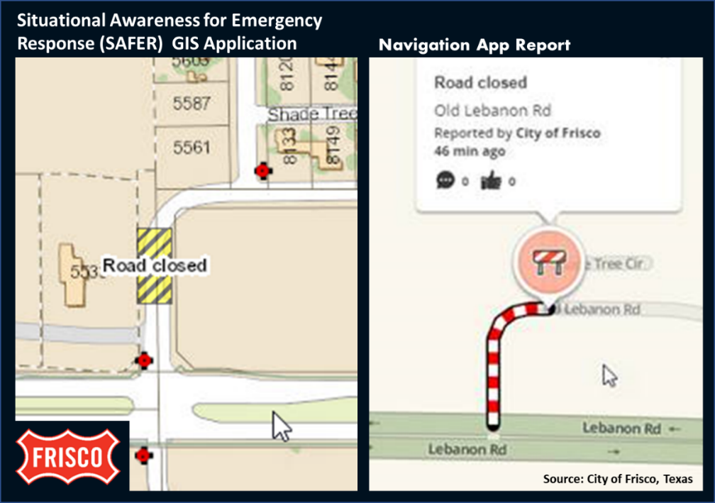
Example: City of Frisco, Texas Improves Public Safety Dispatch
The navigation app-reported incidents occur five to seven minutes earlier than 10 percent of 911 phone calls.¹
When dispatch officers define emergency road closures in their GIS system, they are automatically sent to the navigation app provider and appear on the app interface.
¹Preliminary analysis by City of Frisco, Texas

Slide 68
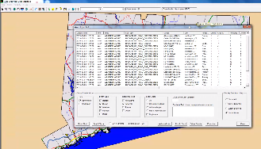
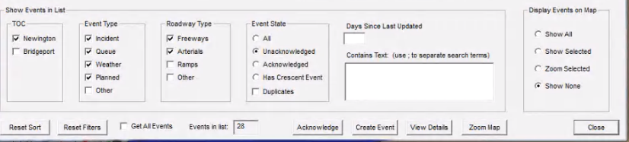
Example: Connecticut DOT Waze Interface Improves Detection and Response
Connecticut DOT developed a Graphics User Interface (GUI) for viewing Waze data.
This simplifies the workload for their operators and expedites incident detection and response strategies.
Source: Connecticut DOT

Slide 69
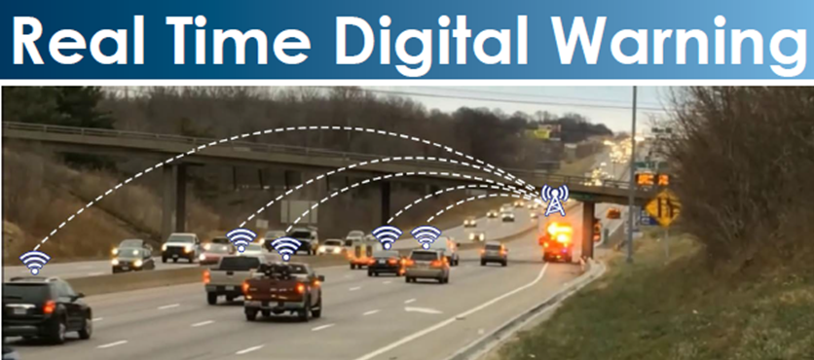
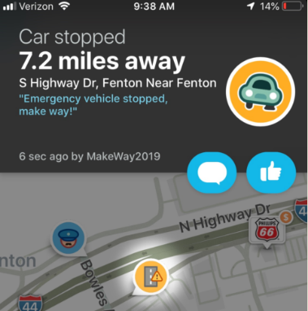
Example: St. Louis, Missouri Improved Incident Responder Safety through Crowdsourcing
Emergency response vehicle collisions with third parties
declined by 40 percent
in St. Louis when alerting motorists of responder activity.
Source: Missouri DOT
Source: Missouri DOT

Slide 70
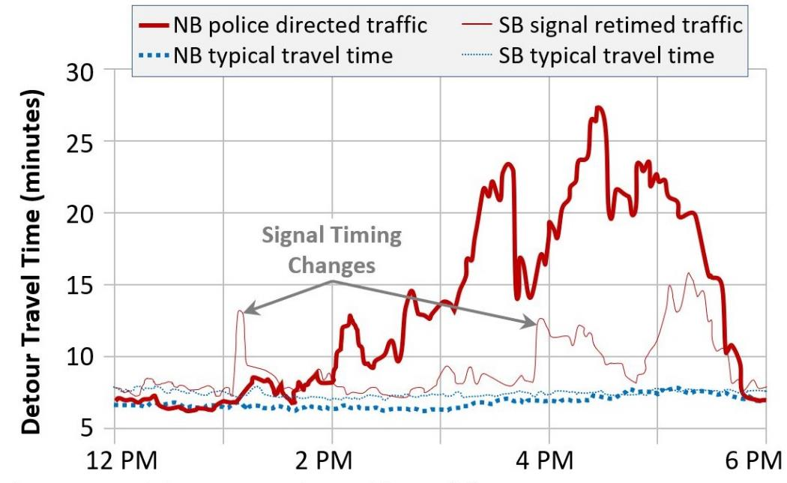
Example: Lake County Real-Time Signal Plans for Arterial Incidents
Signals north of a major crash are switched to two different timing plans using crowdsourced travel time data.
Vehicles approaching the crash, headed southbound, experience far lower travel time compared to police directed northbound traffic.
Source: Lake County DOT

Slide 71
Knowledge Check
How can crowdsourcing data enhance Traffic Incident Management (TIM)?
Faster incident detection.
Identification of back of queues.
Alerting drivers to the presence of roadside responders.
All of the above.
D. All of the above.
Source: Unsplash

Slide 72
TIM Crowdsourcing Resources
Adventures in Crowdsourcing webinars:
Incident Management Tools
Identifying and Managing Back of Queues
Business Case for Crowdsourced Data
Talking TIM webinars:
Innovative Tools for Responder and Road Worker Safety (February 2021)
Protecting the Queue (October 2020)
FHWA EDC-6 Crowdsourcing for Advancing Operation Resource Site (bit.ly/CS4Ops)

Slide 73

Crowdsourcing Traffic Incident Management at the New Jersey Turnpike
Source: Unsplash.

Slide 74
Crowdsourcing for TRAFFIC INCIDENT MANAGEMENT and TRAVELER INFORMATION
74

Slide 75
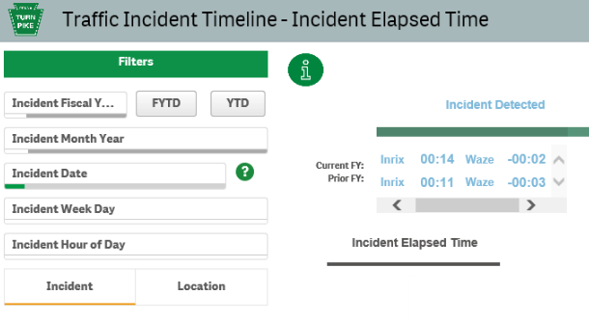
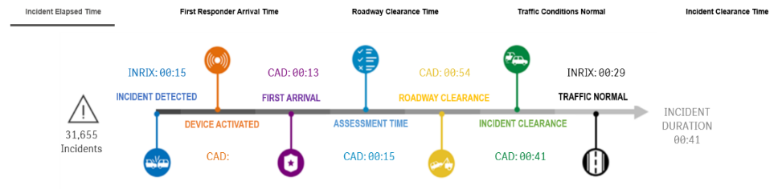
TIM Timeline
Pennsylvania Turnpike now integrates Waze and INRIX data for quicker incident detection, more targeted incident response, broader traveler information, after action reviews, and performance analysis.

Slide 76
PTC Crowdsources Operations
Waze Connected Partner
Share incident and work zone data
PTC receives Waze data for our roadway
PTC can close a road in Waze
PTC can set speed limits and provide other safety messages and planned detours for Waze users
PTC will soon start dispatching via Waze
Working to get Waze Speeds for every mile of the Turnpike
INRIX Probe Speed Data Consumer
Pulls speed data from PTC road segments every 2-minutes
Prioritizes segments with greatest speed differentials

Slide 77
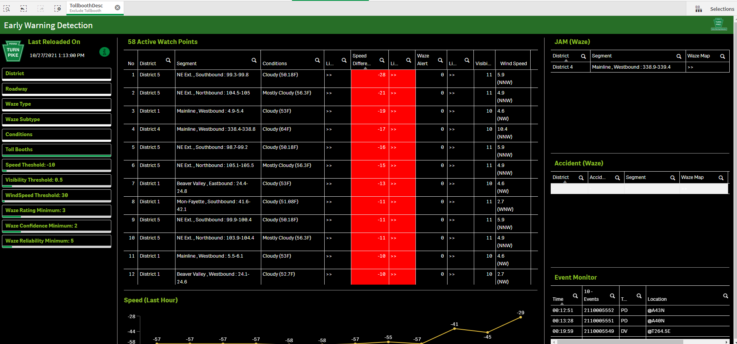
Early Warning Detection Tool

Slide 78
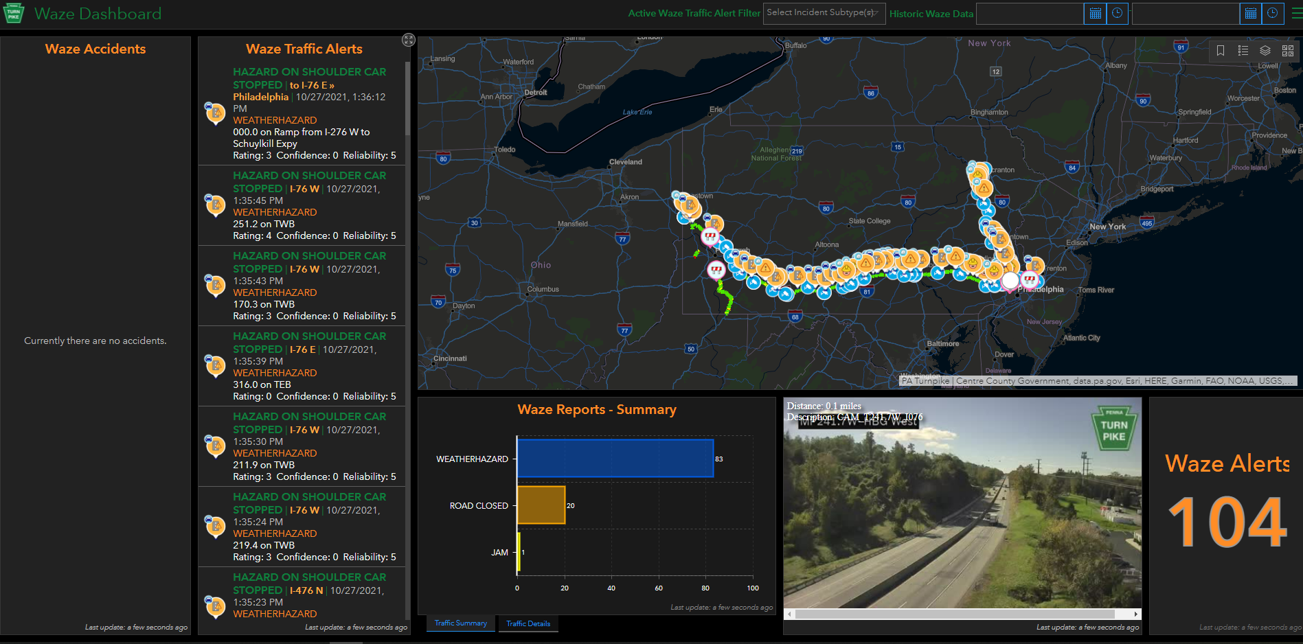
Waze Dashboard
Real-Time Waze alerts
Summary report
Closest camera
Link to Live map
Geolocated to MP

Slide 79
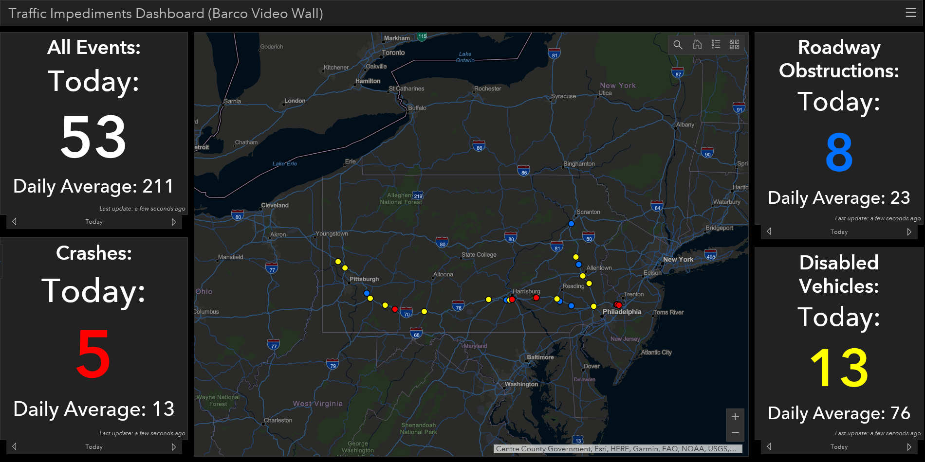
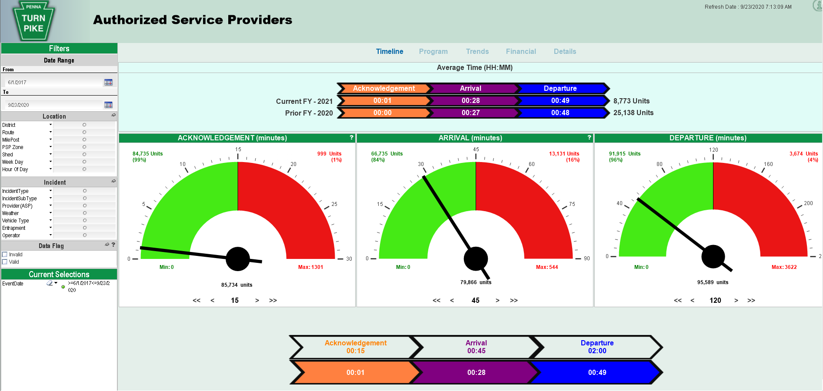
TEO/Geo Analytics Program – Metrics and Dashboards
Turnpike Interactive Mobility & Safety (TIMS) v6
TIMS v4 (Barco Wall)
Traffic Impediments (Barco Wall)
Work Zone Dashboard
Deer Encounters Live
TIMS Viewer Lite
Traffic Impediments (Desktop)
Waze Dashboard
Deer Encounters Analysis
ITS Devices for AET
Early Warning Detection
Active Incident Summary Window (Barco Wall)
Incident Timeline
CADS Reporting
TEO Mobility Dashboard
Executive Mobility Dashboard
ASP Dashboard
Work Zone Crashes Dashboard
Weather Dashboard
Wrong Way Driver Dashboard

Slide 80
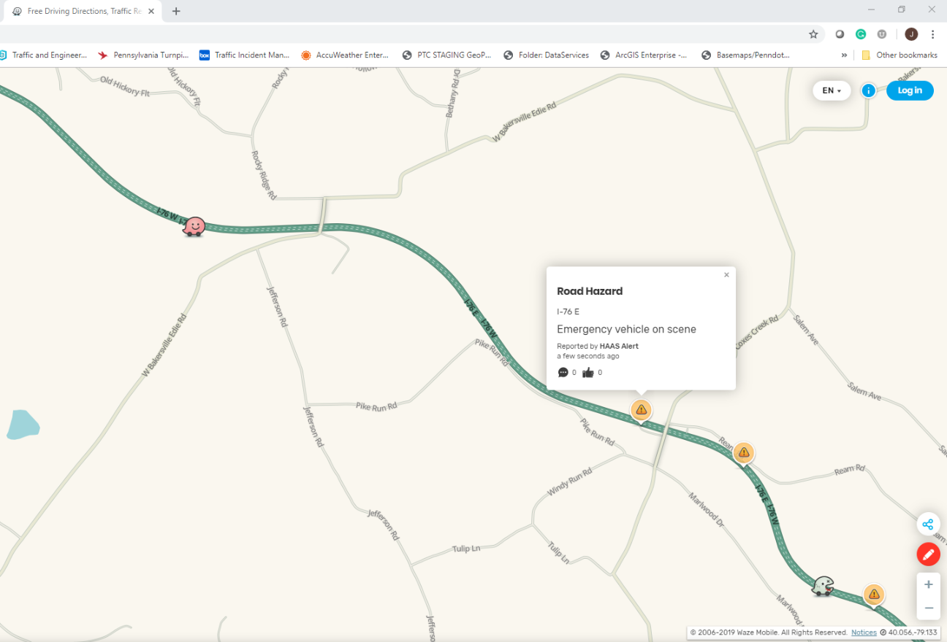
HAAS Alerts
Digital Alerts that go to Waze to tell drivers to Move Over for emergency vehicles that are on scene on the roadway
Activated with light bar
178 vehicles
½ mile alert
Over 7 million driver alerts in the first half year

Slide 81
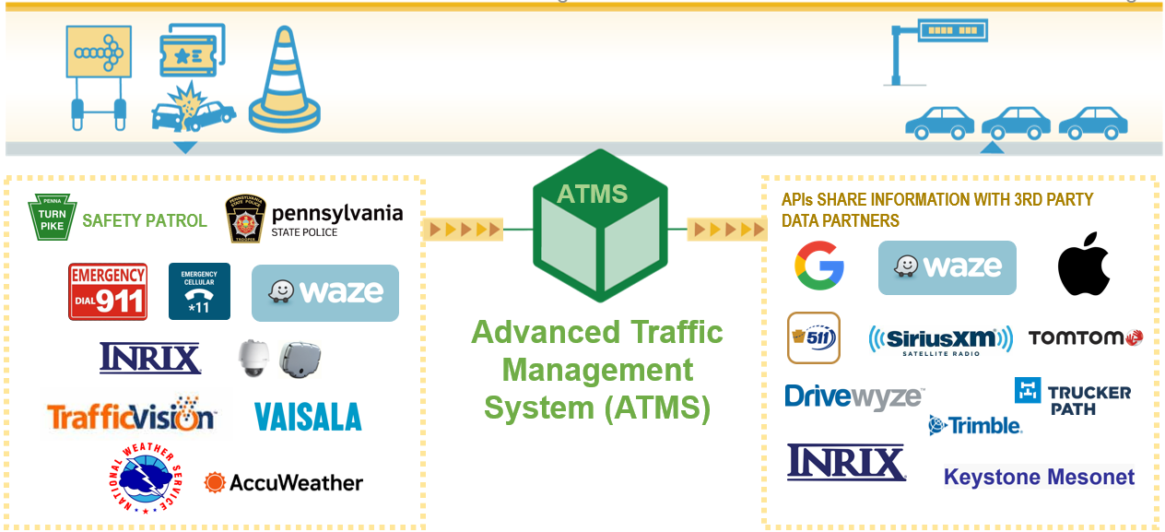


Data Sharing / Partners
In Partnership With:
Built By:
81

Slide 82
Passenger Vehicle Navigation
App name | % of nav app users | PTC agreement | What we Share | US Users (Mil)
WAZE | 23% | Yes – Connected Partner | Crash or Work Zone Closures | 49.9
Google maps | 58% | Yes | Live Road Closure for Crashes Work Zone – Future? | 125.8
Apple maps | 11% | No – in Process and testing feed | Crash or Work Zone Closures | 23.8
82

Slide 83
Commercial Vehicle Navigation
App name | PTC agreement | Time Frame
Trimble – In most ELD devices and GPS units | Yes – Starting to test dev API – Accidents/Road Closurex/Work zone | Late 2021
DriveWyze | Yes – Warn Trucks of Dangerous Curves Dangerous Slowdown and Congestion – 11,000 alerts since Oct 2022 | Since 2019
Freight Waves | Yes – Short-term use for research Long-term adding Accident/Road Closures/Work Zones it to Sonar Map | 2021/22
Trucker Path - #1 | Yes | 2022
OnStar | Yes | 2022
TOM TOM | Yes | 2022
83

Slide 84




Future Connections
MapQuest - Working with contacts
GM – thru SDX (Situational Data Exchange)
FED EX – In conversation with them – They are in process of re-platforming FEDEX ground/air and freight
Amazon Fleet and AWS – to distribute feed
84

Slide 85









Future State of TETC Engagement With Mapping Companies:
Ticketing and Automated Handling
TETC Members
TETC Intake and Delivery
Member Needs
Deliverables
New Features
Trouble Shooting
Technical Advice
TETC Navigation Hub
(ticketing system)
Immediate Needs
Member A
Reports
by
App
Reports
by
Activity
Reports
by
Region
Reports
by
Member
Case
Studies
Training Sessions
and more…
Long Term
Needs
Member B
Staff
Consultants
Relationship
Management
App Backlog
Backlog Progress
Volunteers
Member C

Slide 86

Travel Information Navigation Ticketing Hub
Design completed March 2023
Beta Testing completed April 2023
Project launch held May 11 in Burlington, VT
Coalition training sessions scheduled for June 16 and June 29
TETC Navigation Hub
(ticketing system)
and more…

Slide 87


Thank You!
John Parker
Senior Traffic Operations Project Manager
Pennsylvania Turnpike Commission
Phone: 717-686-8059
cparker@paturnpike.com
87

Slide 88

Question, Answer, and Discussion
Source: Pixabay.

Slide 89
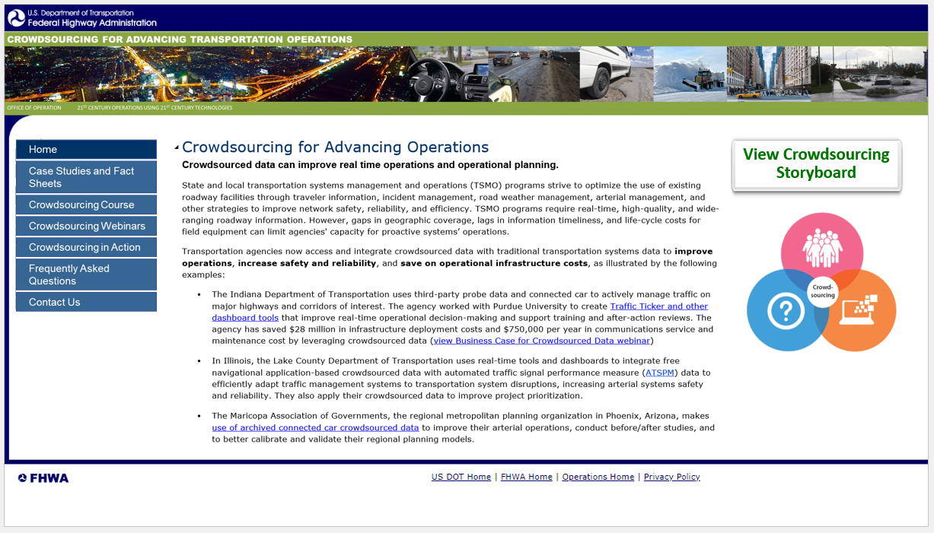
Crowdsourcing Beyond Every Day Counts Round Six
New web presence
Continue course delivery
Continue technical support
Continue free access to the EDC-6 Adventures in Crowdsourcing webinar series hosted by the National Operations Center of Excellence
Source: FHWA.
Concept website in development and intended for FHWA Office of Operations.

Slide 90
Thank you.
James Colyar
james.colyar@dot.gov
360‒753‒9408
Greg Jones
gregm.jones@dot.gov
404‒895‒6220
Ralph Volpe
ralph.volpe@dot.gov
404‒985‒1268

Slide 91
Upcoming T3 Webinars
Webinar | Date | Time
Crowdsourcing for Advancing Operations: Road Weather and Arterial Management | Tuesday, August 15, 2023 | 1:00 P.M. - 2:30 P.M. ET
Crowdsourcing for Advancing Operations: Emergency and Work Zone Management and Next Steps | Tuesday, September 19, 2023 | 1:00 P.M. - 2:30 P.M. ET
Register: https://www.pcb.its.dot.gov/t3_webinars.aspx
To access the recording and past T3 webinars, visit:
https://www.pcb.its.dot.gov/t3_archives.aspx

Slide 92
Feedback
A link to a feedback questionnaire is provided in the chat pod. Please take a few minutes to fill it out – we value your input
To receive notifications of upcoming events, send an email to T3@dot.gov with “Add to mailing list” in the subject line
Thank you!

